Slide 1
Kaggle’s Churn Analysis Challenge
By Graham Herdman

Slide 2
Goals
Identify the maximum accuracy we can achieve for predicting whether a customer will churn and discover which machine learning model will allow us to achieve this.
Notes:
NOTE: Main Focus Was On EDA Because That Was What Was Mentioned In The Email

Slide 3
Goals
Identify the maximum accuracy we can achieve for predicting whether a customer will churn and discover which machine learning model will allow us to achieve this.
Identify the top 5 features that hold the most prediction power in relation to customer churn rate.
Notes:
NOTE: Main Focus Was On EDA Because That Was What Was Mentioned In The Email

Slide 4
Goals
Identify the maximum accuracy we can achieve for predicting whether a customer will churn and discover which machine learning model will allow us to achieve this.
Identify the top 5 features that hold the most prediction power in relation to customer churn rate.
(hopefully) Impress my audience so that I can get the job!
Notes:
NOTE: Main Focus Was On EDA Because That Was What Was Mentioned In The Email

Slide 5
EDA – Summary of Data Set
3333 Entries
21 Features
6 Categorical Features (Included ‘area code’, ‘phone number’, ‘customer service calls’)
14 Numeric Features
1 Label Variable (Binary)

Slide 6
Cleaning The Data

Slide 7
Getting A Feel For The Data

Slide 8
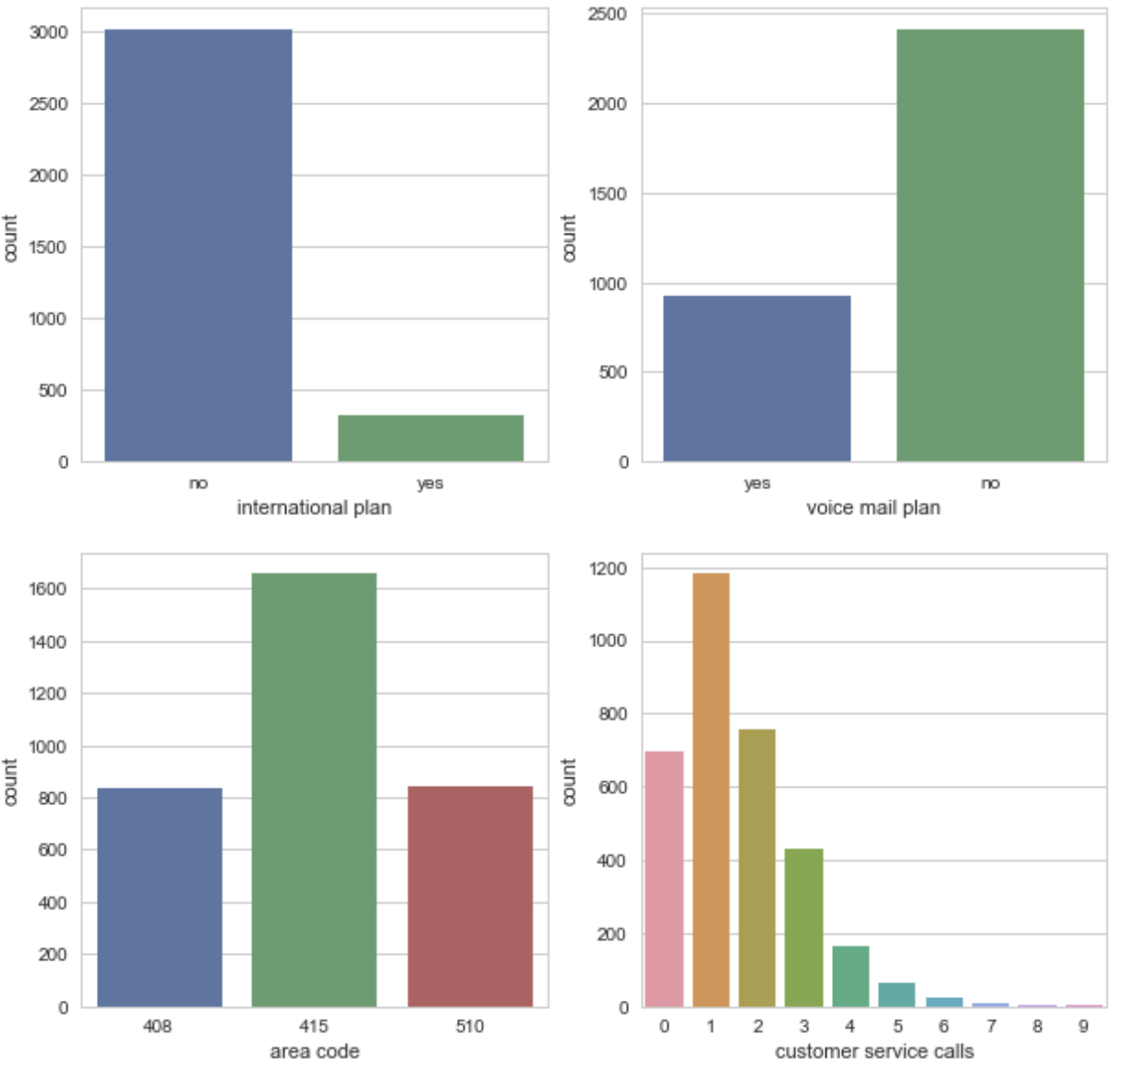
Categorical Features – Univariate

Slide 9
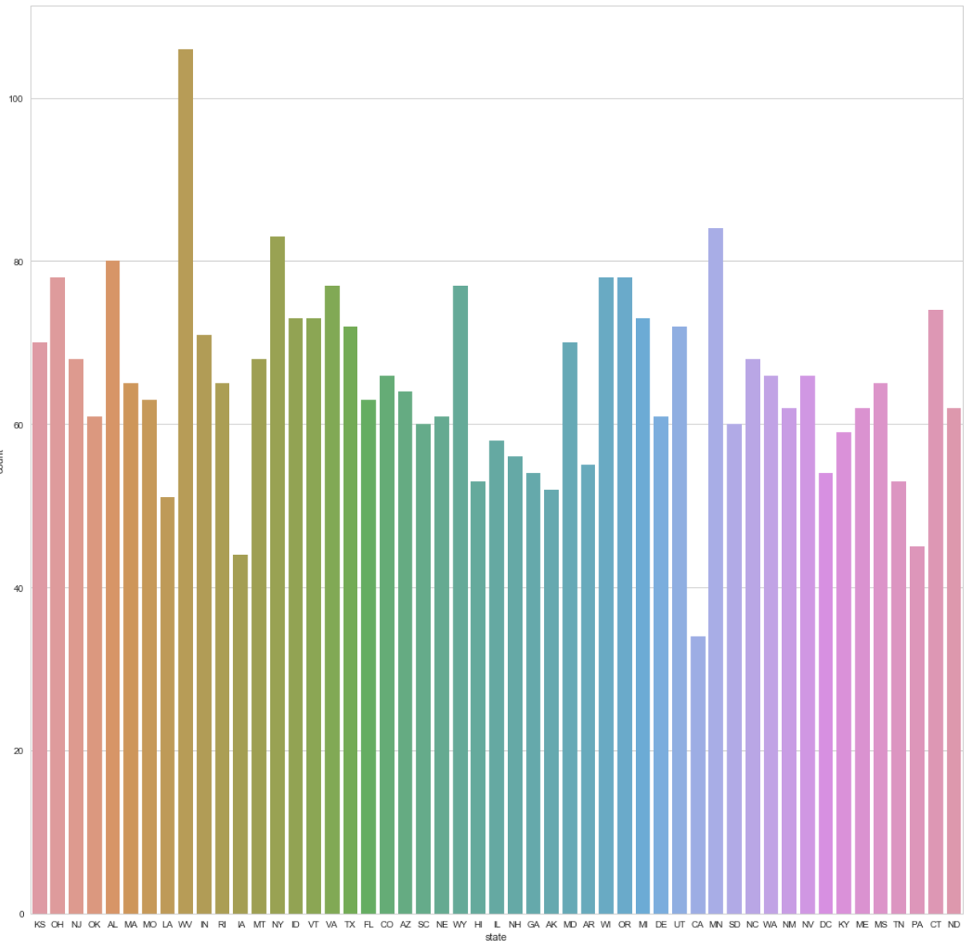
Categorical Features – Univariate

Slide 10
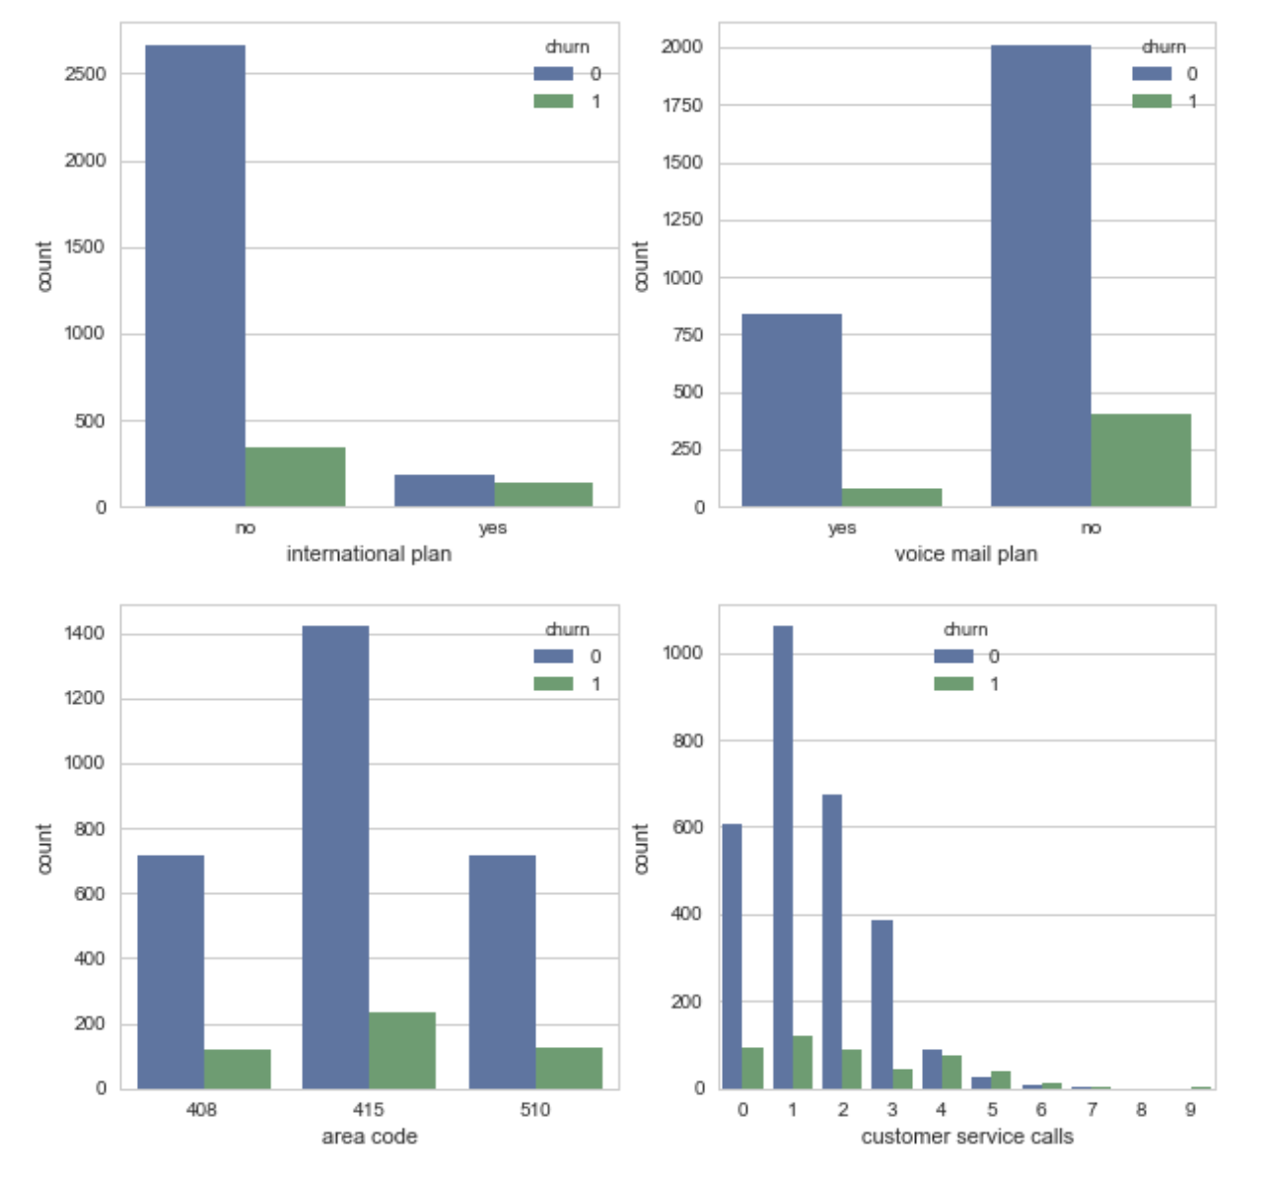
Categorical Features – Multivariate, Unadjusted

Slide 11
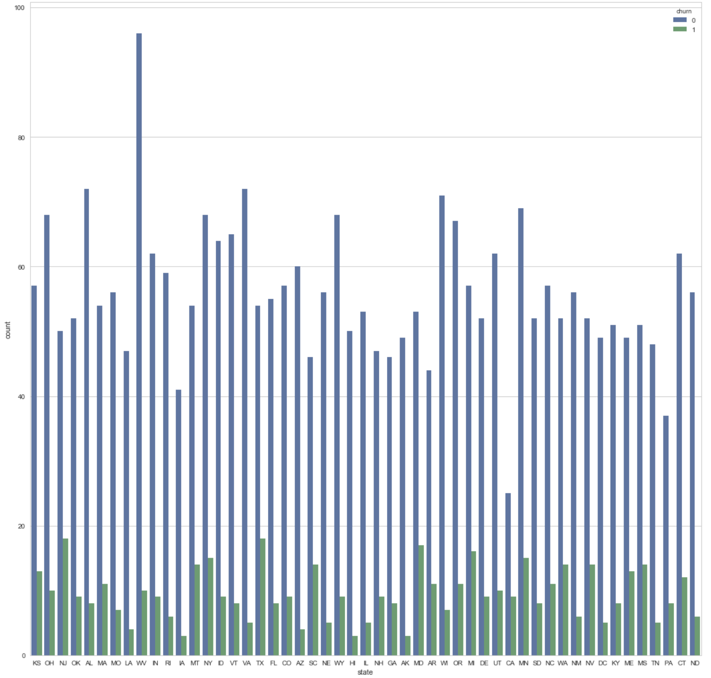
Categorical Features – Multivariate, Unadjusted

Slide 12
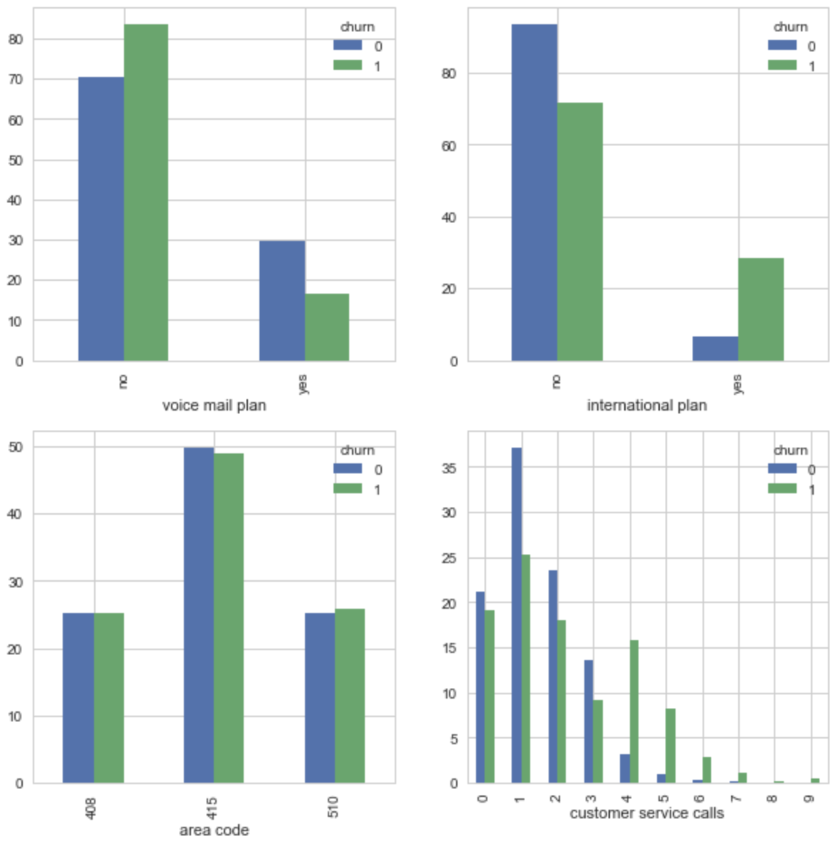
Categorical Features – Adjusted, Multivariate

Slide 13
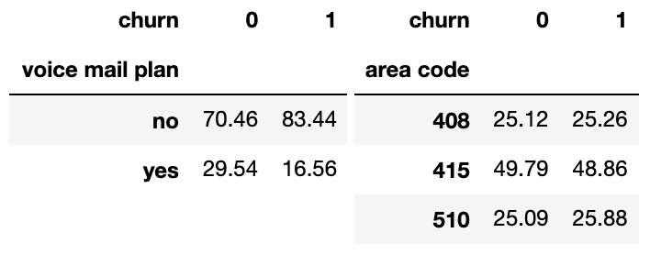
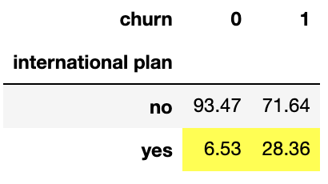
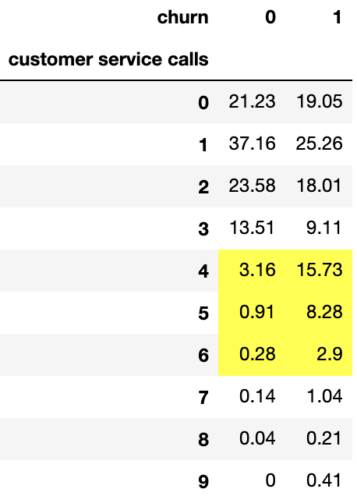
Categorical Features – Adjusted, Multivariate

Slide 14
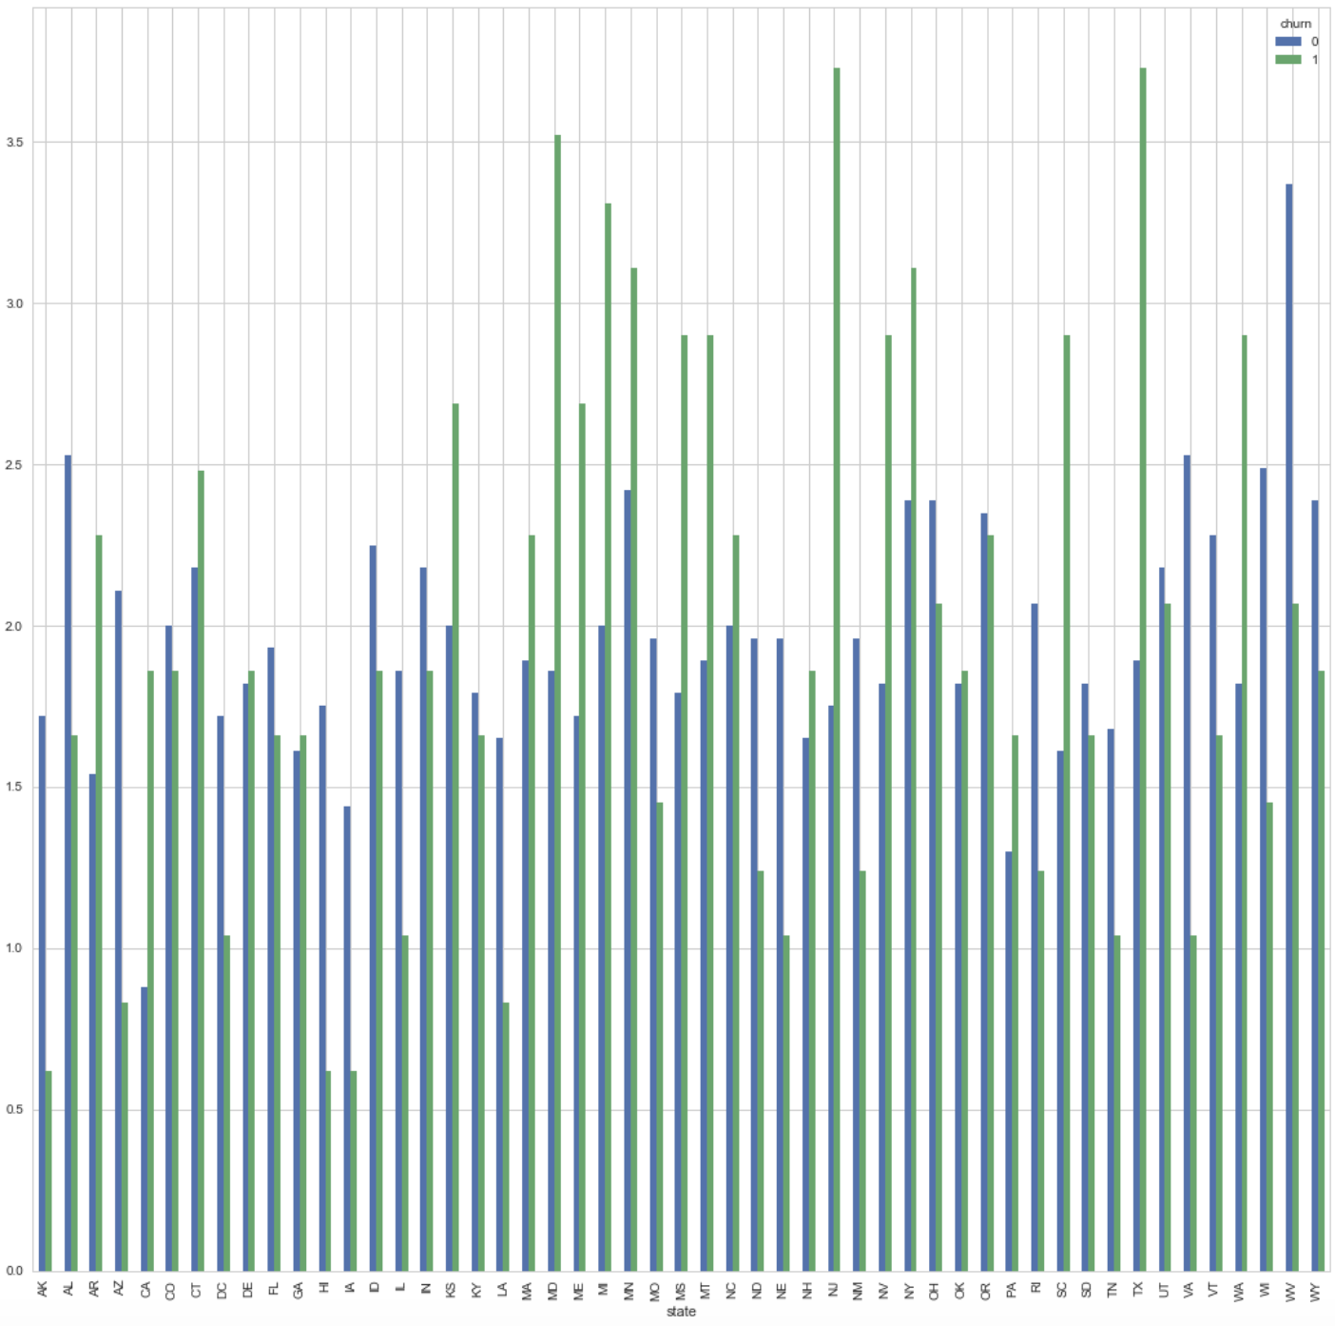
Categorical Features – Adjusted, Multivariate

Slide 15
Categorical Features – Adjusted, Multivariate

Slide 16
Numeric Features: Mean Values

Slide 17
Numeric variables: Box plot and Histograms

Slide 18
Heatmap

Slide 19
Baseline Accuracy For Our Models
Baseline 1: 85.51%
Rule: Choose Majority Class (Loyal)
Baseline 2: 85.81%
Rule: if (Customer Service Calls > 3) & (International Plan == True) ==> churn=1
else:
churn=0
Baseline 3: 86.32%
Rule: if (Customer Service Calls > 3) & (in_top_15_states == True) ==> churn=1
else
churn=0
Notes:
Incorporating more information from the exploratory data analysis each time

Slide 20
Model Evaluation

Slide 21
XGBoost

